Slide 1
Matrices

Slide 2
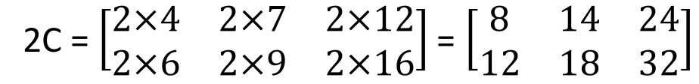
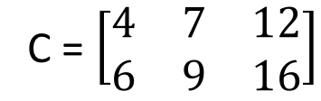
Multiplication of Matrices
Recall scalar multiplication
Given a matrix C, if the matrix is multiply by a number, them all the elements in the matrix is multiply by the number.
C = $\left[\begin{matrix}4 & 7 & 12 \\ 6 & 9 & 16\end{matrix}\right]$
2C = $\left[\begin{matrix}2×4 & 2×7 & 2×12 \\ 2×6 & 2×9 & 2×16\end{matrix}\right]$ = $\left[\begin{matrix}8 & 14 & 24 \\ 12 & 18 & 32\end{matrix}\right]$

Slide 3
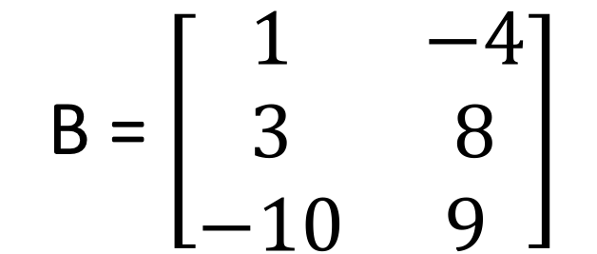
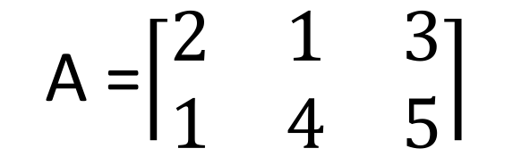
Matrix multiplication
Consider the following matrices:
B = $\left[\begin{matrix}1 & −4 \\ 3 & 8 \\ −10 & 9 \end{matrix}\right]$
A =$\left\lceil \begin{matrix}2 & 1 & 3 \\ 1 & 4 & 5\end{matrix}\right\rceil$

Slide 4
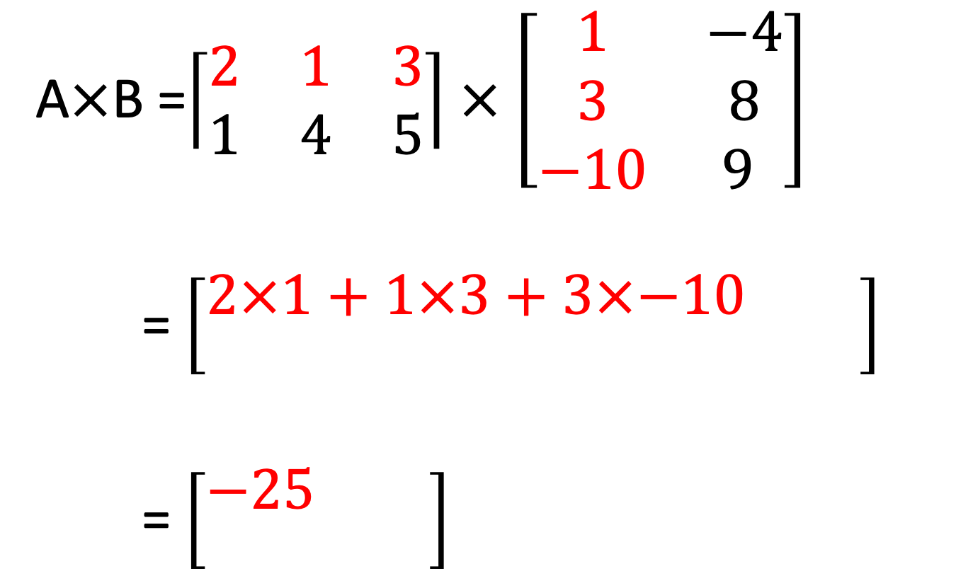
A$×$B =$\left\lceil \begin{matrix}2 & 1 & 3 \\ 1 & 4 & 5\end{matrix}\right\rceil$ $×$ $\left[\begin{matrix}1 & −4 \\ 3 & 8 \\ −10 & 9 \end{matrix}\right]$
= $\left[\begin{matrix}2×1+1×3+3×−10 & \\ & \end{matrix}\right]$
= $\left[\begin{matrix}−25 & \\ & \end{matrix}\right]$

Slide 5
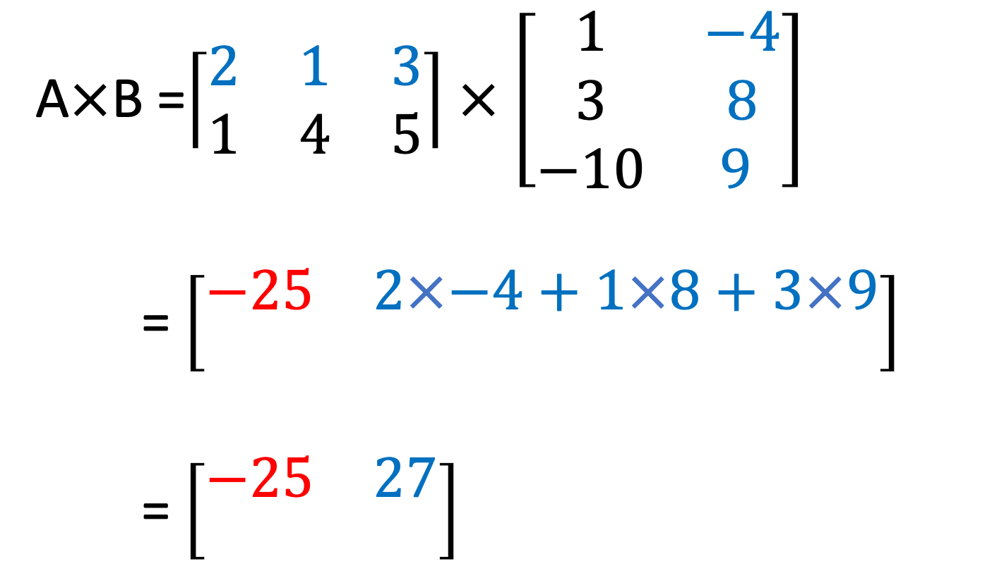
A$×$B =$\left\lceil \begin{matrix}2 & 1 & 3 \\ 1 & 4 & 5\end{matrix}\right\rceil$ $×$ $\left[\begin{matrix}1 & −4 \\ 3 & 8 \\ −10 & 9 \end{matrix}\right]$
= $\left[\begin{matrix}−25 & 2×−4+1×8+3×9 \\ & \end{matrix}\right]$
= $\left[\begin{matrix}−25 & 27 \\ & \end{matrix}\right]$

Slide 6
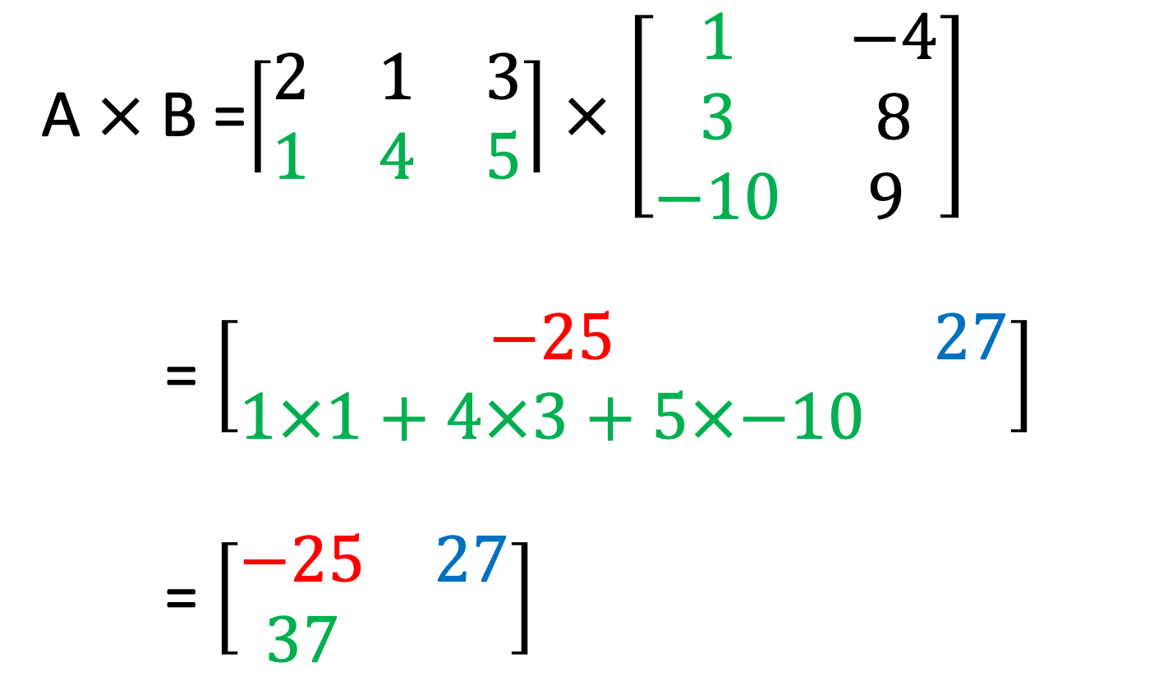
A $×$B =$\left\lceil \begin{matrix}2 & 1 & 3 \\ 1 & 4 & 5\end{matrix}\right\rceil$ $×$ $\left[\begin{matrix}1 & −4 \\ 3 & 8 \\ −10 & 9 \end{matrix}\right]$
= $\left[\begin{matrix}−25 & 27 \\ 1×1+4×3+5×−10 & \end{matrix}\right]$
= $\left[\begin{matrix}−25 & 27 \\ 37 & \end{matrix}\right]$

Slide 7
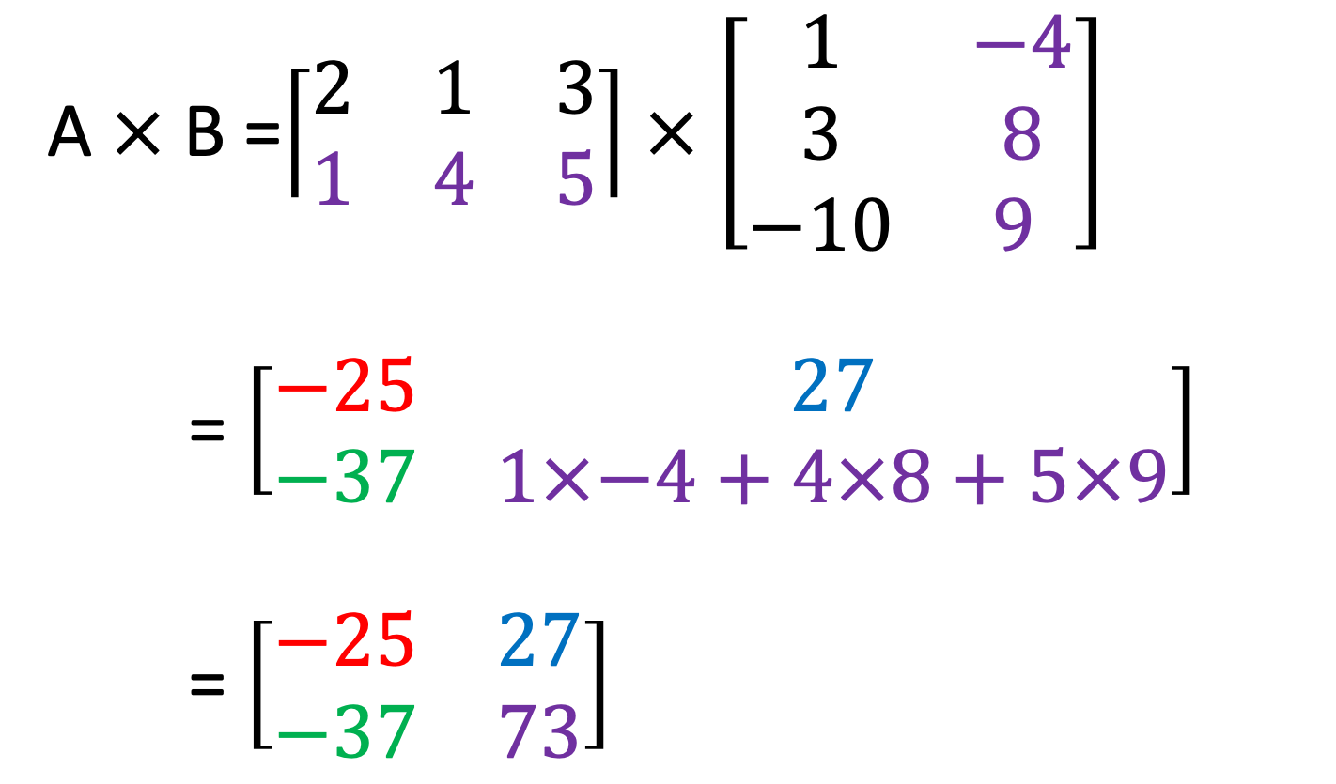
A $×$B =$\left\lceil \begin{matrix}2 & 1 & 3 \\ 1 & 4 & 5\end{matrix}\right\rceil$ $×$ $\left[\begin{matrix}1 & −4 \\ 3 & 8 \\ −10 & 9 \end{matrix}\right]$
= $\left[\begin{matrix}−25 & 27 \\ −37 & 1×−4+4×8+5×9\end{matrix}\right]$
= $\left[\begin{matrix}−25 & 27 \\ −37 & 73\end{matrix}\right]$

Slide 8
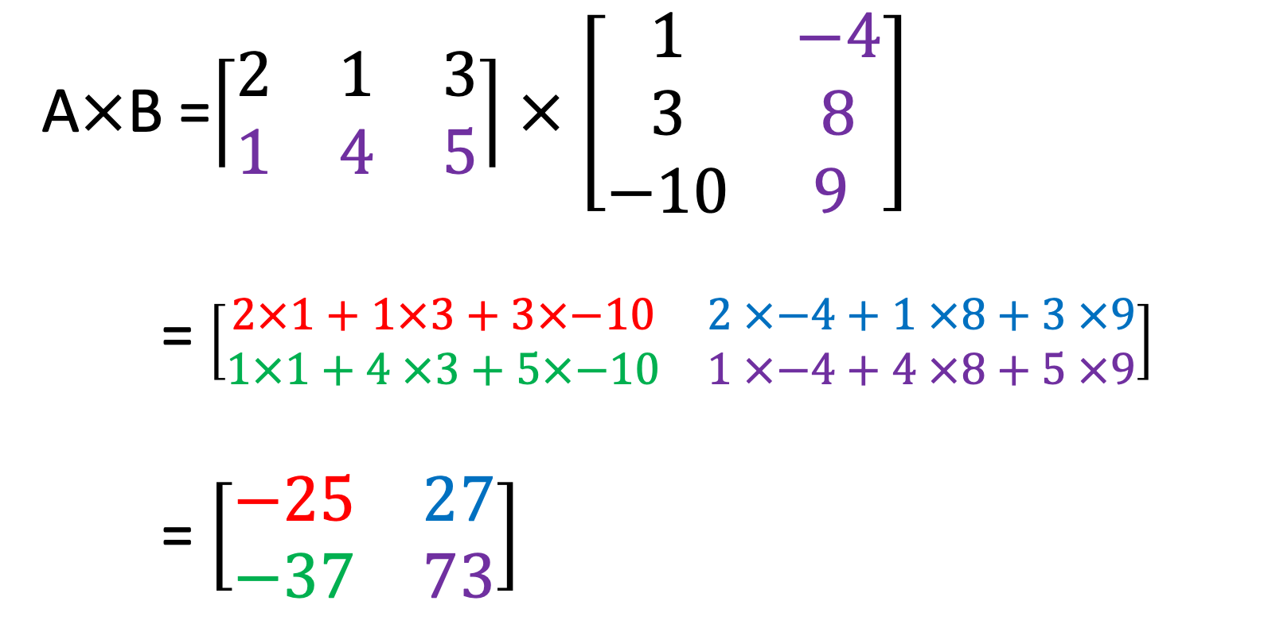
A$×$B =$\left\lceil \begin{matrix}2 & 1 & 3 \\ 1 & 4 & 5\end{matrix}\right\rceil$ $×$ $\left[\begin{matrix}1 & −4 \\ 3 & 8 \\ −10 & 9 \end{matrix}\right]$
= $\left[\begin{matrix}2×1+1×3+3×−10 & 2 ×−4+1 ×8+3 ×9 \\ 1×1+4 ×3+5×−10 & 1 ×−4+4 ×8+5 ×9\end{matrix}\right]$
= $\left[\begin{matrix}−25 & 27 \\ −37 & 73\end{matrix}\right]$

Slide 9




Other examples

Slide 10




1 x 2 2 x 2 1 x 2
2 x 2 2 x 2 2 x 2
1 x 2 2 x 3 1 x 3
2 x 2 2 x 1 2 x 1

Slide 11
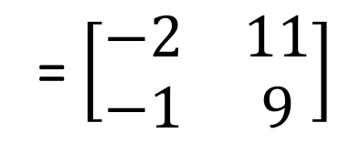

= $\left[\begin{matrix}−2 & 11 \\ −1 & 9\end{matrix}\right]$
In matrix multiplication, AB $≠$BA, therefore matrix multiplication is not commutative.

Slide 12
Two matrices can be multiplied together if the number of columns in the first matrix equals the number of the number of rows in the second matrix.
If matrix A has dimensions of m x n and matrix B has dimensions of p x q
The matrix product A_{mxn}B_{pxq} can only be formed if n = p and AB will have dimensions m x q
The matrix product B_{pxq}A_{mxn} can only be formed if q = m and AB will have dimensions p x n
In the product AB,
B is premultiplied by A
A is postmultiplied by B

Slide 13
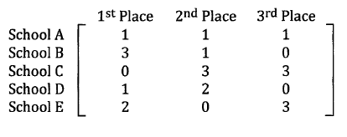
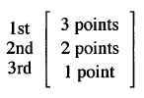

Practical examples
= $\left[\begin{matrix}\begin{matrix}6 \\ 11\end{matrix} \\ 9 \\ \begin{matrix}7 \\ 9\end{matrix}\end{matrix}\right]$

Slide 14
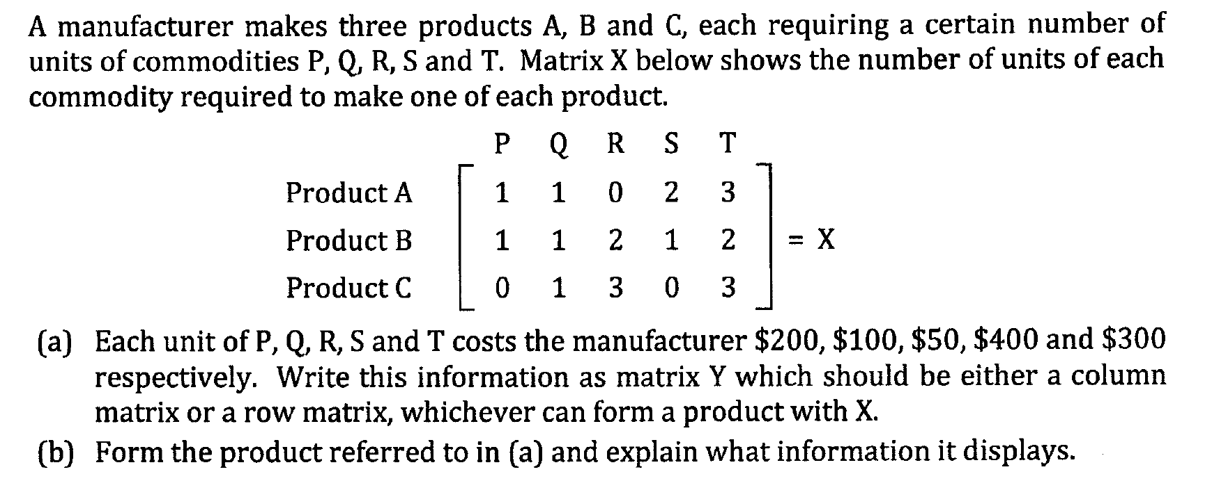

Slide 15
Zero matrices
All elements in a zero matrix is 0.
The letter O is used to represent a zero matrix
For any matrix A,
A + O = A
O + A = A
A * O = O
O * A = O
O is referred to as additive identity matrix

Slide 16
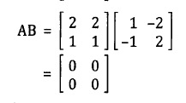
Note
If x and y represents number, if xy = 0, then either x = 0 and/or y = 0.
However for matrices, if AB = O, it is not necessarily that A and/or B = O

Slide 17
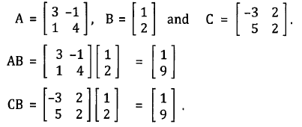
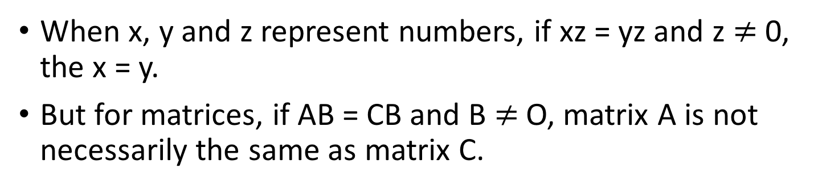
Note
When x, y and z represent numbers, if xz = yz and z $≠$ 0, the x = y.
But for matrices, if AB = CB and B $≠$ O, matrix A is not necessarily the same as matrix C.

Slide 18


Multiplicative Identity Matrices
A multiplicative identity matrix leaves all other matrices unchanged under multiplication
If I _{mxn} is a multiplicative matrix
I_{mxn} A_{nxp} = A_{nxp} thus m = n
B_{qxm}I_{mxn} = B_{qxn} thus m = n
Therefore I is a square matrix.
$$\left[\begin{matrix}1 & 0 & 0 \\ 0 & 1 & 0 \\ 0 & 0 & 1\end{matrix}\right]$$
$$\left[\begin{matrix}1 & 0 \\ 0 & 1\end{matrix}\right]$$

Slide 19

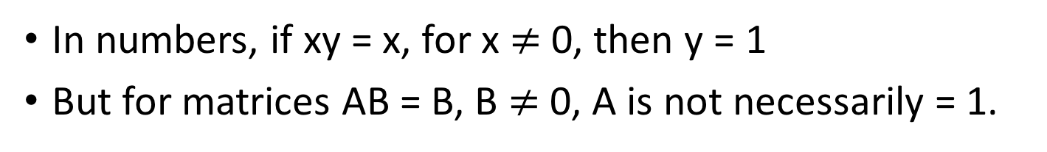
Note
In numbers, if xy = x, for x $≠$ 0, then y = 1
But for matrices AB = B, B $≠$ 0, A is not necessarily = 1.

